Slide 1
Section 7: AIS RAD KGML

Slide 2
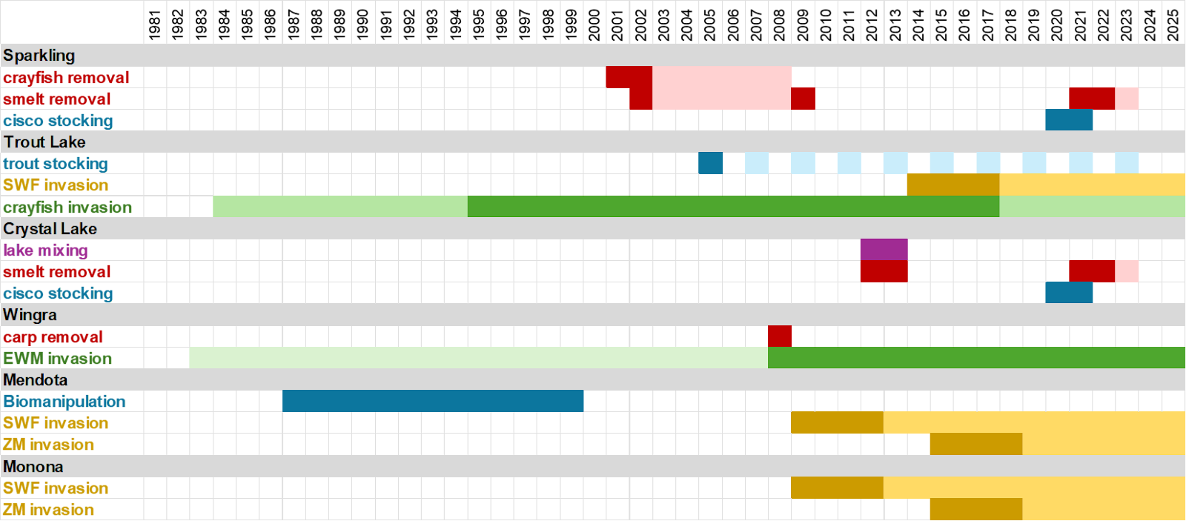

Slide 3
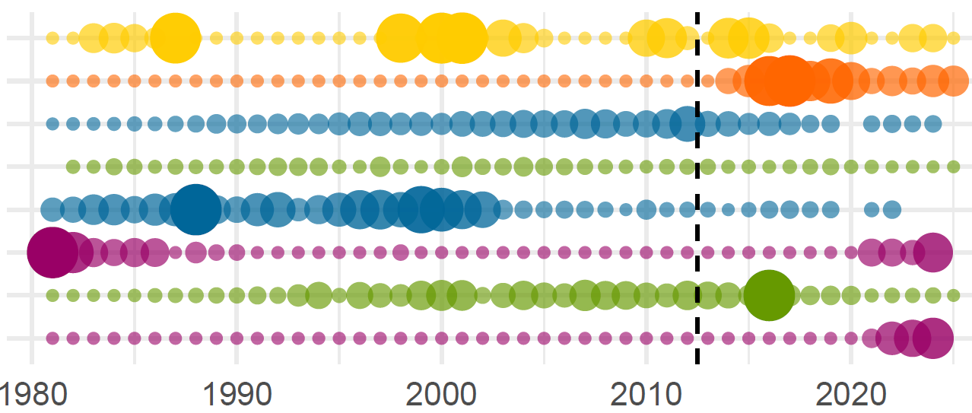
NHLD
Perturbations
NATIVE SPP
INTRODUCED
Lake Trout
Spiny Water Flea
Rusty Crayfish
Cisco
Smelt
Trout Lk
Sparkling
Crystal

Slide 4
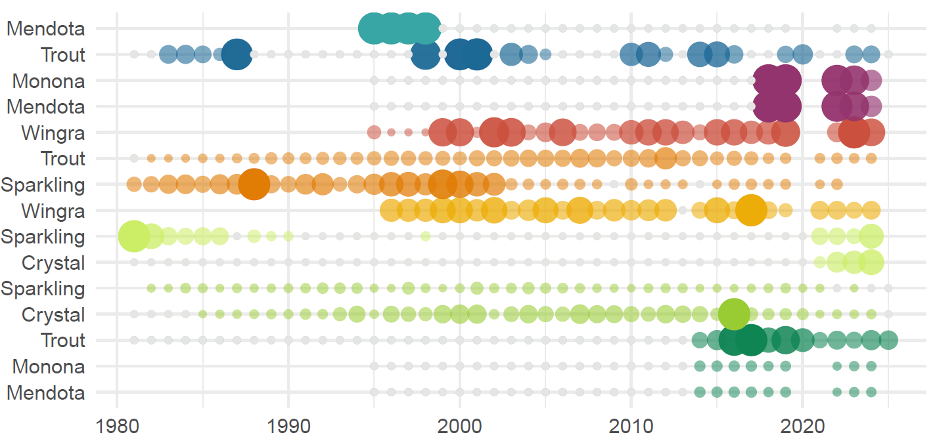
Pisc
ME
+
+
+
+
Piscivore stocking
+
+
+
+
+
TR
Benthic
Zebra Mussels
ME
!
MO
!
Carp
WI
×
Rusty Crayfish
TR
×
×
SP
Cisco Stocking
SP
+
Planktivore
+
CR
SP
×
×
×
Rainbow Smelt
×
×
×
CR
TR
!
Spiny Water Flea
ME
!
MO
!

Slide 5
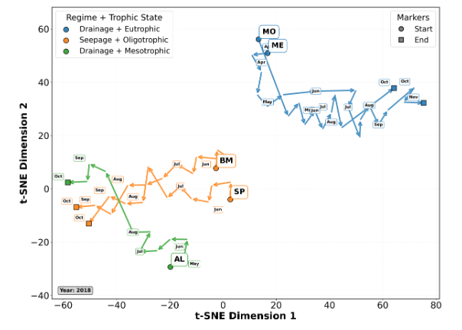
60
Hydrology & Trophic State
Seepage & Oligotrophic
Drainage & Mesotrophic
Drainage & Eutrophic
Markers
Start of Ice-Free Season
End of Ice-Free Season
Monona
Mendota
40
20
t-SNE Dimension 2
Big Musky
0
Sparkling
-20
Allequash
-40
Year: 2018
-60
-40
-20
0
20
40
60
80
t-SNE Dimension 1

Slide 6
